Slide 1

E-Commerce Data Analysis Project
Shruti nigam

Slide 2
Project Description
An international e-commerce company based wants to discover key insights from their customer database. They want to use some of the most advanced machine learning techniques to study their customers. The company sells electronic products.

Slide 3
Data Description
The dataset used for model building contained 10999 observations of 12 variables.
Variables:
ID: ID Number of Customers.
Warehouse block: The Company have big Warehouse which is divided in to block such as A,B,C,D,E.
Mode of shipment: The Company Ships the products in multiple way such as Ship, Flight and Road.
Customer care calls: The number of calls made from enquiry for enquiry of the shipment.
Customer rating: The company has rated from every customer. 1 is the lowest (Worst), 5 is the highest (Best).

Slide 4
Data Description cont..
Prior purchases: The Number of Prior Purchase.
Product importance: The company has categorized the product in the various parameter such as low, medium, high.
Gender: Male and Female.
Discount offered: Discount offered on that specific product.
Weight in grams: It is the weight in grams.
Reached on time: It is the target variable, where 1 Indicates that the product has NOT reached on time and 0 indicates it has reached on time.

Slide 5
Tasks Included in the project
1. Data Exploration and Cleaning
2. Data Visualization
3. Feature Engineering
4. Model Building
5. Model Tuning
6. Data Visualization with Power BI
7. Reporting

Slide 6
Data Exploration and cleaning
The dataset having 10999 observations with 12 variables for building the model.
The ID variable contain the unique number and also corresponded with rows number so it was removed.
All the categorical variable converted into numeric variable.
The dataset was checked for missing values. There were no missing values.
The target variable had 6563 shipments didn’t reach on-time and while 4436 shipments that reached on-time.
Average order value was 210.19 US Dollars. It is the average amount a customer ends up spending per transaction.

Slide 7
Data Exploration and cleaning cont..
Maximum no. of customer in dataset had prior purchase is 3 products. and minimum no. of customer in dataset had prior purchase is 8 products.
Majority of the customer rated as 3 which is received their order on-time.
Majority of products were of low importance.
Most activity from the F block of the warehouse.
A large share of deliveries were done by ships.
Maximum no. of customer in dataset made 4 calls to customer care.

Slide 8
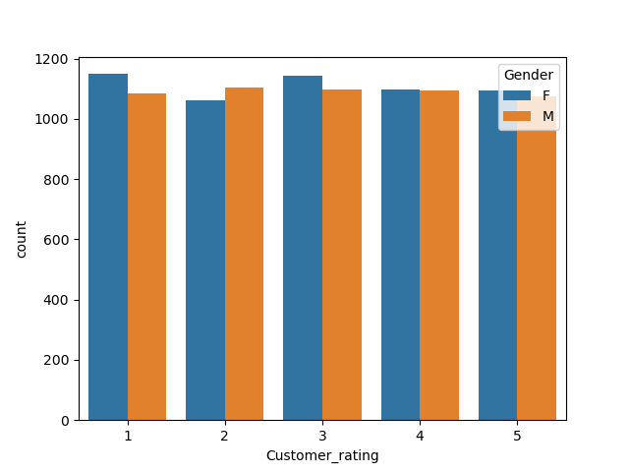
Data Visualization
# visualising customer ratings gender wise

Slide 9
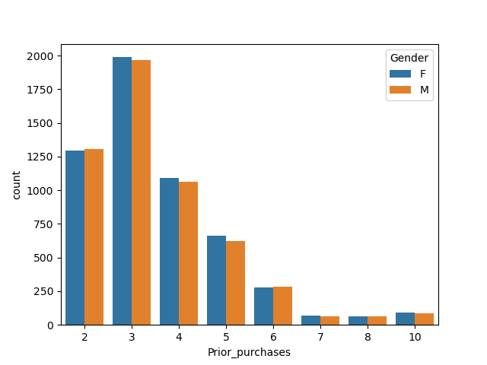
# visualising previous purchases gender wise

Slide 10
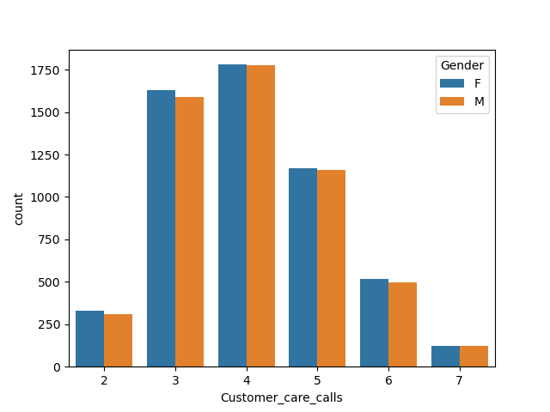
# visualising calls received by customer care
centres gender wise

Slide 11
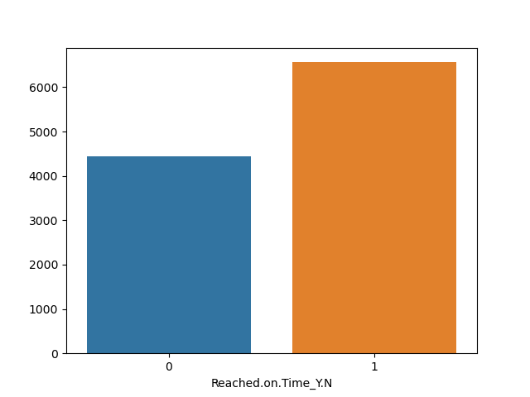
# plotting no. of items reached on time and no. of items which are late

Slide 12
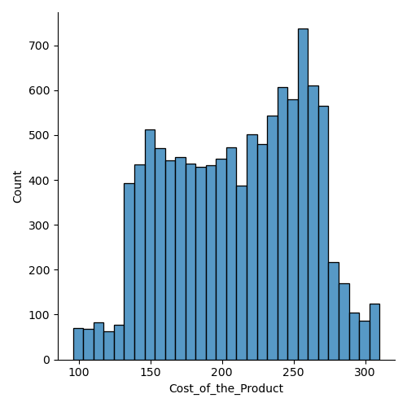
# no. of products sold vs cost of the products sold

Slide 13
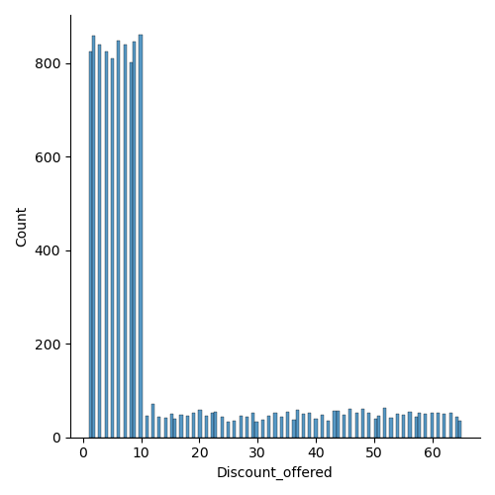
# discounts offered on no. of products

Slide 14
Comparing the accuracy of predictions by different models used
The accuracy of the Decision tree model is 0.6575757575757576 i.e. 65.75%
The accuracy of the Random Forest classifier model is 0.6619834710743802 i.e. 66.19%
The accuracy of the KNN model is 0.6586776859504132 i.e. 65.86%
Accuracy after tuning 0.6741046831955922 i.e. 67.41%

Slide 15
Conclusion:
This project successfully explored and analyzed the E-commerce dataset. Key insights were derived through visualizations, and predictive models were built to forecast delivery outcomes.
Random Forest proved to be the most effective model, and hyperparameter tuning further enhanced its accuracy.

Slide 16
Thank you!!

